Slide 1

Credit Card Decision with Machine Learning
Deniz ACAROGLU
2022/07/19

Slide 2


28 Million New Credit Cards
Approximately 20 Million Rejections
19,5 Million Customers

Slide 3
The Problem
Reviewing applications without machine learning is almost impossible.
High company resource costs for decision making
Due to high volume of applications hard to make best decision to bank interests.
After COVID approval and rejection patterns are changed due to global financial hardship for everyone.

Slide 4
The Data
Data
The data used for prediction is a sample data.
It has 690 entries.(44.5% approval & 55.5% rejection)
Features
Gender, Age, Debt, MaritalStatus, BankCustomer, EducationLevel, Ethnicity, YearsEmployed, PrevBankruptcy, Employed, CreditScore, DriversLicense, Citizen, PostalCode, Income, ApprovalStatus.

Slide 5
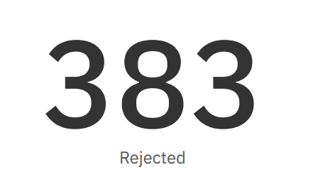
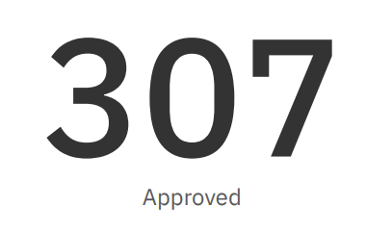
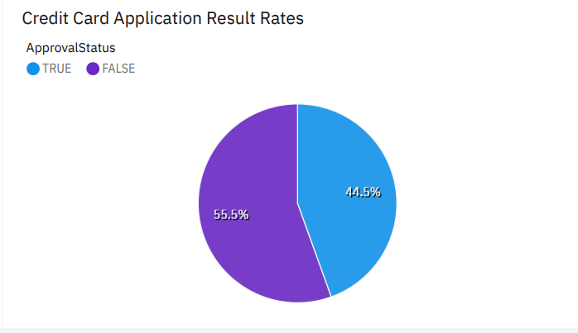
Insights

Slide 6
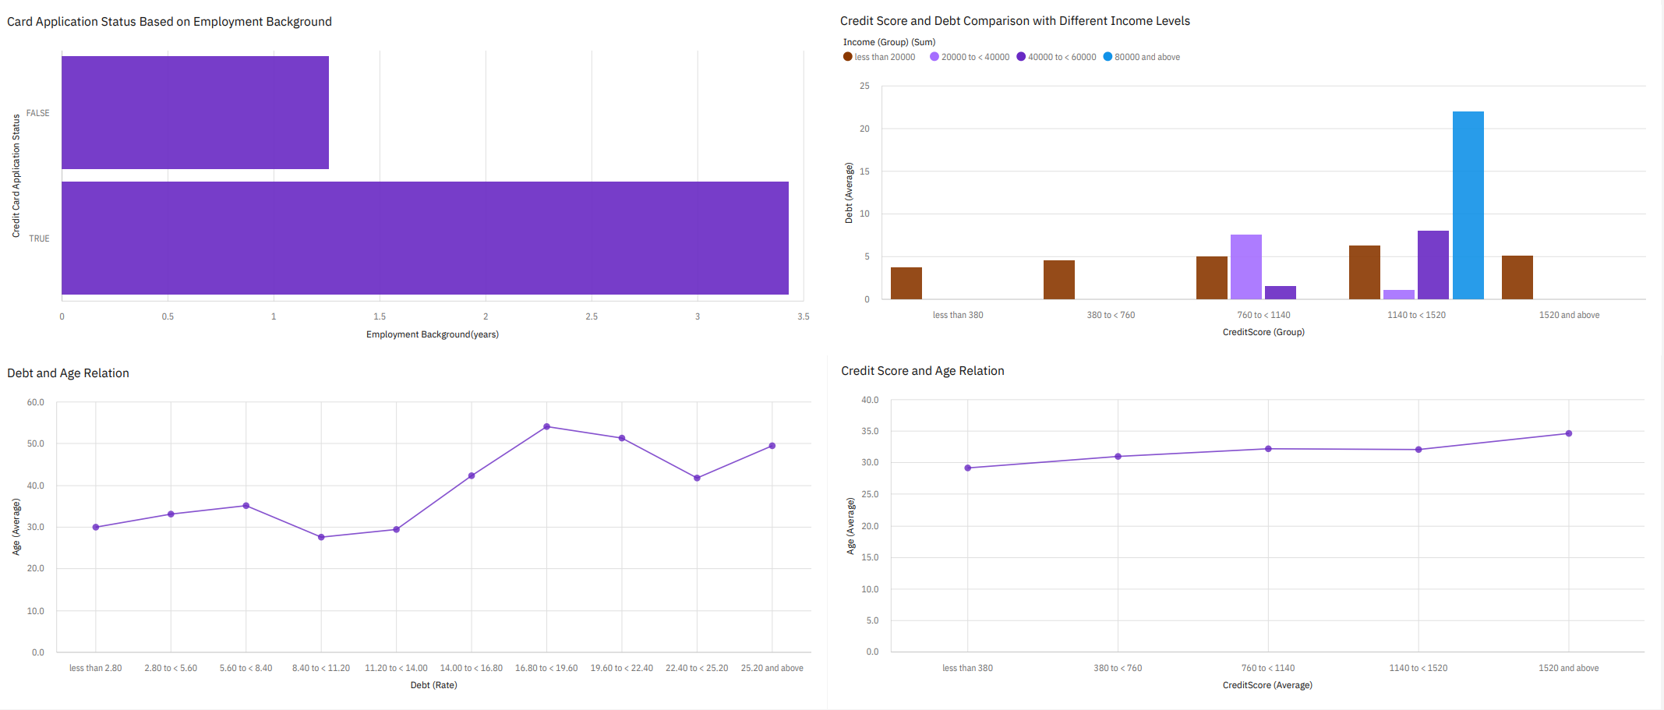
Insights

Slide 7
Insights

Slide 8
Machine Learning Approach
Logistic regression for prediction
We are expecting yes or no(aka Binary) as a prediction results.
Logistic regression is a good fit.
Features to be used for regression analysis;
Gender
Age
Debt Owned(by rate)
Marital Status
Customer of Bank
Level of Education
Ethnicity
Previous Bankruptcy
Employment Background(Duration)
Credit Score
Drivers License,
Citizen
Income Level
Decision.
Accuracy and Confusion Matrix
Logistic Regression
Accuracy
0.8156522561297263
Confusion Matrix
[89 14]
[22 103]
89 Data is came out True Positive
103 Data came out True Negative
Missed 35 data point

Slide 9
Conclusion
With Logistic Regression we have succeeded over 80% accuracy.
More data point needed than 691 sample data to fit our model better.
With help of machine learning Algorithm we saved lot of resource can be even more with tweaking the model.
When our age is growing bigger our debt and credits growing even further.
To Improve
Further Data analysis; For the applicants with account might be observed for their spendings on decision making.
Decide on people’s behavioral change on their finances.
Dataset can be segmented before and after covid for more precise decision.
Breakeven point to be calculated for accuracy of our model if target misses more than we were before.

Slide 10

Thank you

